Slide 1
Magic Of Micro-Controller
An Intensive Training Course on Micro-Controller
Brought To You By TechShopBD.Com

Slide 2
Topics
Bitwise Operations
Bitwise AND
Bitwise OR
Bitwise NOT
Bitwise Left-Shift
Bitwise Right-Shift
Logical Assignment Operator
Logical Equivalents
First AVR Program
Blinking LED

Slide 3
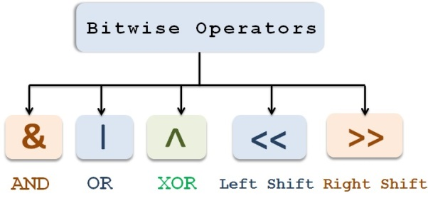
Bitwise Operation
In digital computer programming, a bitwise operation operates on one or more bit patterns or binary numerals at the level of their individual bits.

Slide 4
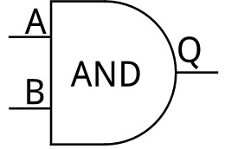
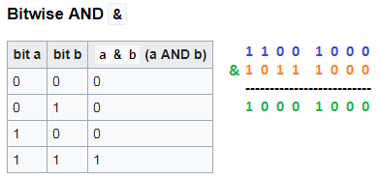
Bitwise AND
The bitwise AND operator is a single ampersand: &. It is just a representation of AND and work according to the truth table of AND gate.

Slide 5
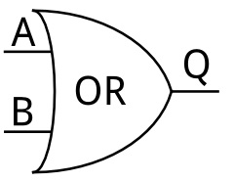
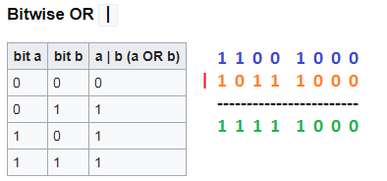
Bitwise OR
The bitwise OR operator is a single pipe: |. The pipe is a computer keyboard key, which is just a representation of OR and work according to the truth table of OR gate.

Slide 6
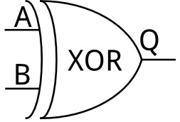
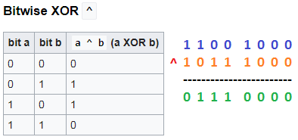
Bitwise X-OR
The bitwise XOR (exclusive or) performs a logical XOR function. XOR can be used to toggle the bits between 1 and 0.

Slide 7

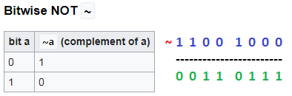
Bitwise NOT
We get the inverted bits, for every bit 1 the result is bit 0 and conversely for every bit 0 we have a bit 1.

Slide 8


Bitwise Left-Shift
The symbol of left shift operator is <<. It shifts each bit in its right-hand operand to the left.
1
1
0
0
1
0
0
0
1
1
0
0
1
0
0
0
0
0

Slide 9

Bitwise Right-Shift
The symbol of right shift operator is >>. It shifts each bit in its left-operand to the right.
1
1
0
0
1
0
0
0
0
0
1
1
0
0
1
0
0
0

Slide 10
Logical Assignment Operator
C provides a compound assignment operator for each binary arithmetic and bitwise operation (i.e. each operation which accepts two operands).
Each of the compound bitwise assignment operators perform the appropriate binary operation and store the result in the left operand.

Slide 11
Logical Assignment Operator
Bitwise | Logical
&= | bitwise AND assignment
|= | bitwise inclusive OR assignment
^= | bitwise exclusive OR assignment
<<= | Left Shift assignment
>>= | Right Shift assignment

Slide 12
Logical Equivalent
Four of the bitwise operators have equivalent logical operators. They are equivalent in that they have the same truth tables.
Bitwise | Logical
A & B | A && B
A | B | A || B
A ^ B | A != B
~A | !A

Slide 13
Assignment
Write a program, that will turn ON and OFF of all PORTD of ATmega32 sequentially after every 500ms.

Slide 14
Any Question ?

Slide 15
Thank You

